Slide 1
Topic molding
Mohamed Kotb

Slide 2
Outlines
Project Description - Approach
Loading and viewing the dataset
Cleaning Data – Data Preprocessing
New approach by Keywords
Latent Dirichlet Allocation (LDA)
Result Visualization

Slide 3
Description
Researchers have access to large online archives of scientific articles. As a consequence, finding relevant papers has become more difficult. Newly formed online communities of researchers sharing citations provides a new way to solve this problem. In this paper, we develop an algorithm to recommend scientific articles to users of an online community. Our approach combines the merits of traditional collaborative filtering and probabilistic topic modeling. It provides an interpretable latent structure for users and items, and can form recommendations about both existing and newly published articles.

Slide 4
Approach
You are provided with a medical related dataset, containing 5k articles. You are required to demonstrate your NLP, data-mining & topic extraction skills to extract the topics that are included within the dataset along with mapping each article to the corresponding topic names. Each document should be matched to the top three most relevant topic names including the matching probability score.

Slide 5
Loading and viewing the dataset & Cleaning DAta

Slide 6
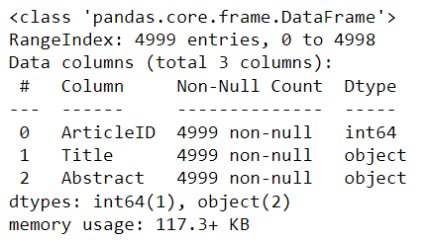
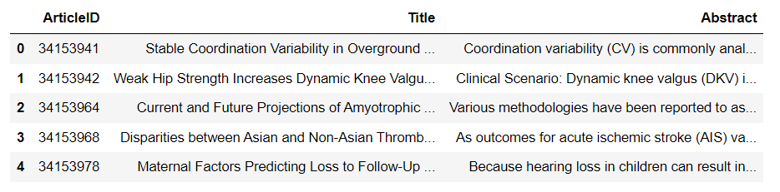
Load Data
INFO:
Use simple pandas Library :
df = pd.read_csv('Pubmed5k.csv')
print(df.shape)
df.head()
Number of training sentences: 4999

Slide 7
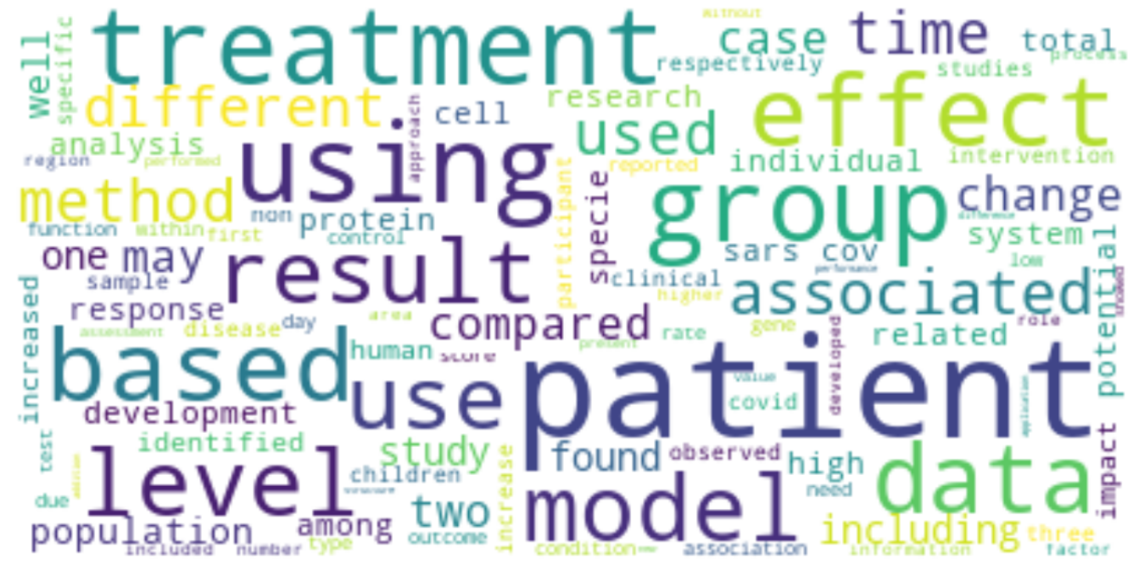
Cleaning Data
Combine the ['Title', 'Abstract'] columns to one column.
Drop unused columns.
Remove punctuation from sentence.
Change all word to lowercase.
Remove numbers from sentence.

Slide 8
Data preprocessing
Tokenize each text using {NLTK tokenizer}
Apply Preprocessing on the Corpus (lemmatization):
Split into words and remove any stop words present
Remove any stop words present
Remove punctuations + normalize the text
Clean data stored in a new list
Lemma Corpus:
['stable', 'coordination', 'variability', 'overground', 'walking', 'running', 'preferred', 'fixed', 'speed', 'stable', 'coordination', 'variability’,'overground', 'walking', 'running', 'preferred', 'fixed', 'speed', 'stable', 'coordination', 'variability', 'overground', 'walking', 'running', 'preferred’, 'fixed', 'speed', 'stable', 'coordination', 'variability', 'overground', 'walking', 'running', 'preferred', 'fixed', 'speed', 'stable', 'coordination', 'variability', 'overground', 'walking', 'running', 'preferred', 'fixed', 'speed', 'coordination', 'variability', 'cv', 'commonly', 'analyzed', 'understand', 'dynamical', 'quality', 'human', 'locomotion', 'purpose', 'study', 'develop', 'guideline', 'number', 'trial', 'required', 'inform', 'calculation', 'stable', 'mean', 'lower', 'limb', 'cv', 'overground', 'locomotion', 'threedimensional', 'lower', 'limb', 'kinematics', 'captured', 'recreational', 'runner', 'performing', 'trial', 'preferred', 'fixed', 'speed', 'walking', 'running', 'stance', 'phase', 'cv', 'calculated', 'segment', 'joint', 'coupling', 'using', 'modified', 'vector', 'coding', 'technique', 'number', 'trial', 'required', 'achieve', 'cv', 'mean', 'within', 'stride', 'average', 'determined', 'coupling', 'individual', 'statistical', 'output', 'mode', 'walking', 'v', 'running', 'speed', 'preferred', 'v', 'fixed', 'compared', 'informed', 'differing', 'number', 'trial', 'minimum', 'trial', 'required', 'stable', 'mean', 'stance', 'phase', 'cv', 'fewer', 'trial', 'cv', 'underestimated', 'led', 'oversight', 'significant', 'difference', 'mode', 'speed', 'future', 'overground', 'locomotion', 'cv', 'research', 'healthy', 'population', 'using', 'vector', 'coding', 'approach', 'trial', 'standard', 'minimum', 'researcher', 'aware', 'notable', 'consequence', 'insufficient', 'number', 'trial', 'overall', 'study', 'finding']

Slide 9
Data preprocessing
Bigrams:
Build the bigram
Faster way to get a sentence clubbed as a trigram/bigram
Form Bigrams and trigrams
Dictionary and Corpus:
Creating the term dictionary of our courpus that is of all the words (Sepcific to Genism syntax perspective), where every unique term is assigned an index.
Converting list of documents (corpus) into Document Term Matrix using the dictionary

Slide 10
New approach by Keywords

Slide 11
Data preprocessing
Bigrams:
Build the bigram
Faster way to get a sentence clubbed as a trigram/bigram
Form Bigrams and trigrams
Dictionary and Corpus:
Creating the term dictionary of our courpus that is of all the words (Sepcific to Genism syntax perspective), where every unique term is assigned an index.
Converting list of documents (corpus) into Document Term Matrix using the dictionary

Slide 12
Keywords
Keywords are words that capture the essence of your article. Keywords make your paper searchable and ensure that you get more citations. Therefore, it is important to include the most relevant keywords that will help other authors find your article.
Each article must have Keyword
For that I try to get the topics from Keywords

Slide 13
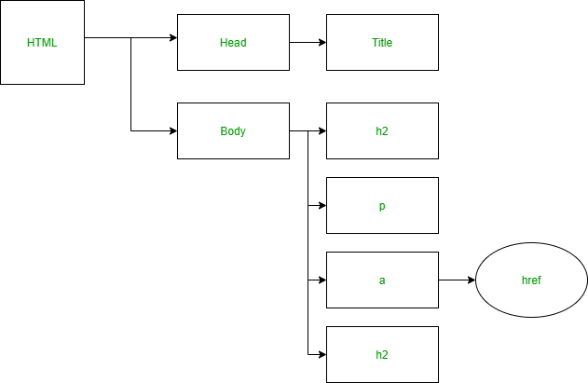
Web Scraping
We will be using the lxml library for Web Scraping and the requests library for making HTTP requests in Python. These can be installed in the command line using the pip package installer for Python.
Getting data from an element on the webpage using lxml requires the usage of Xpaths.
Using XPath
XPath works very much like a traditional file system
Using LXML
Step-by-step Approach
We will use requests.get to retrieve the web page with our data.
We use html.fromstring to parse the content using the lxml parser.
We create the correct XPath query and use the lxml xpath function to get the required element.

Slide 14
Web Scraping
We will be using the lxml library for Web Scraping and the requests library for making HTTP requests in Python. These can be installed in the command line using the pip package installer for Python.
Getting data from an element on the webpage using lxml requires the usage of Xpaths.
Using XPath
XPath works very much like a traditional file system
Using LXML
Step-by-step Approach
We will use requests.get to retrieve the web page with our data.
We use html.fromstring to parse the content using the lxml parser.
We create the correct XPath query and use the lxml xpath function to get the required element.

Slide 15
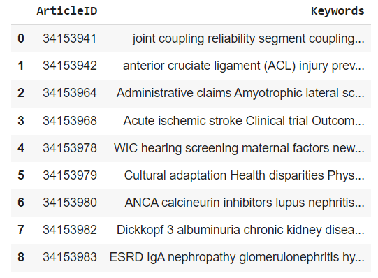
Web Scraping
Use website: https://pubmed.ncbi.nlm.nih.gov/
To get keyword of each article by ID of article

Slide 16
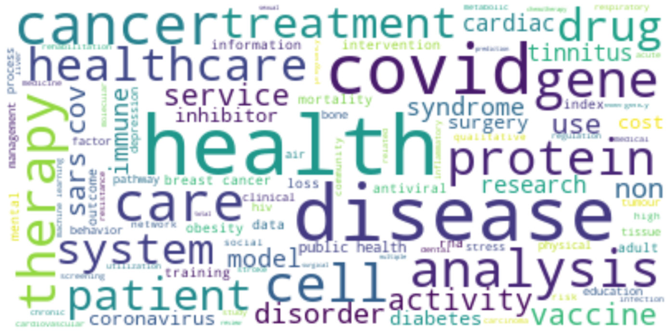
Key words (Visualization)

Slide 17
Latent Dirichlet Allocation (LDA)

Slide 18
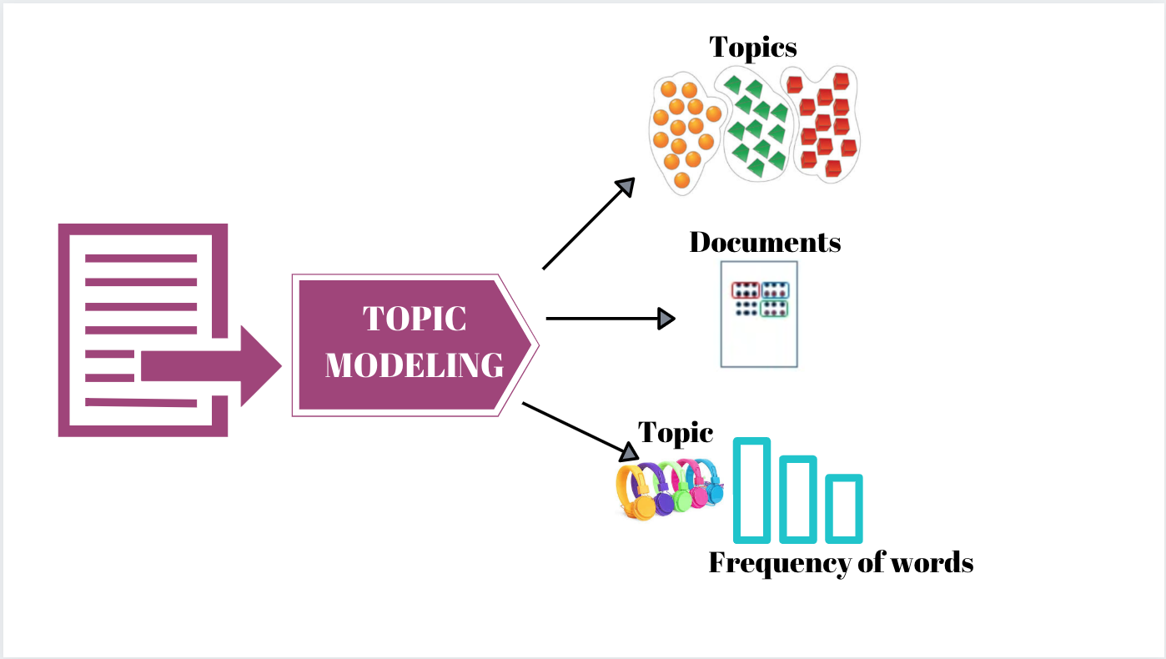
LDA
Latent Dirichlet Allocation (LDA) is one of the ways to implement Topic Modelling. It is a generative probabilistic model in which each document is assumed to be consisting of a different proportion of topics.
How does the LDA algorithm work?
1) For each document, randomly initialize each word to a topic amongst the K topics where K is the number of pre-defined topics.
2) For each document d:
For each word w in the document, compute:
P(topic t| document d): Proportion of words in document d that are assigned to topic t
P(word w| topic t): Proportion of assignments to topic t across all documents from words that come from w
3) Reassign topic T’ to word w with probability p(t’|d)*p(w|t’) considering all other words and their topic assignments
The last step is repeated multiple times till we reach a steady state where the topic assignments do not change further. The proportion of topics for each document is then determined from these topic assignments.
https://www.analyticsvidhya.com/blog/2021/06/part-2-topic-modeling-and-latent-dirichlet-allocation-lda-using-gensim-and-sklearn/

Slide 19
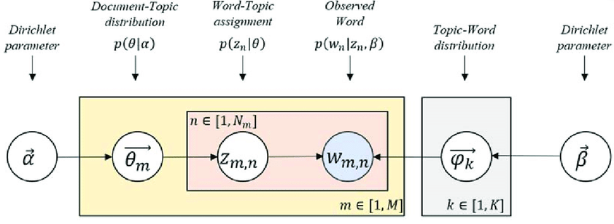
LDA Theory
According to LDA, every word is associated (or related) with a latent (or hidden) topic, which here is stated by Z. Now, this assignment of Z to a topic word in these documents gives a topic word distribution present in the corpus that is represented by theta (𝛳).
The LDA model has two parameters that control the distributions:
Alpha (ɑ) controls per-document topic distribution, and
Beta (ꞵ) controls per topic word distribution
To summarize:
M: is the total documents in the corpus
N: is the number of words in the document
w: is the Word in a document
z: is the latent topic assigned to a word
theta (𝛳): is the topic distribution
LDA model s parameters: Alpha (ɑ) and Beta (ꞵ)

Slide 20
How will LDA optimize the distributions?
The end goal of LDA is to find the most optimal representation of the Document-Topic matrix and the Topic-Word matrix to find the most optimized Document-Topic distribution and Topic-Word distribution.
As LDA assumes that documents are a mixture of topics and topics are a mixture of words so LDA backtracks from the document level to identify which topics would have generated these documents and which words would have generated those topics.
Now, our corpus that had 5 documents (D1 to D5) and with their respective number of words:
D1 = (w1, w2, w3, w4, w5, w6, w7, w8)
D2 = (w`1, w`2, w`3, w`4, w`5, w`6, w`7, w`8, w`9, w`10)
D3 = (w“1, w“2, w“3, w“4, w“5, w“6, w“7, w“8, w“9, w“10, w“11, w“12, w“13, w“14 w“15)
D4 = (w“`1, w“`2, w“`3, w“`4, w“`5, w“`6, w“`7, w“`8, w“`9, w“`10, w“`11, w“`12)
D5 = (w““1, w““2, w““3, w““4, w““5, w““6, w““7, w““8, w““9, w““10,…, w““32, w““33, w““34)

Slide 21
Hyperparameters Tuning
LDA:
id2word=dict_,num_topics=9,random_state=100update_every=1, chunksize=100,passes=10,
alpha='auto’
Coherence Score: 0.4215158617266439
Gensim:
id2word=dict_,num_topics=k,random_state=100 chunksize=100,passes=10,alpha='auto’
Coherence Score: 0.44675946984645165

Slide 22
Results for (Abstract)

Slide 23
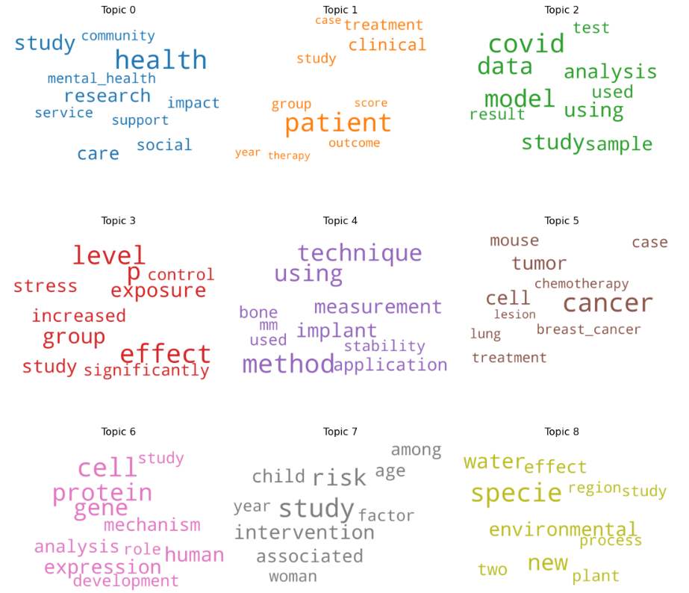
Topics

Slide 24
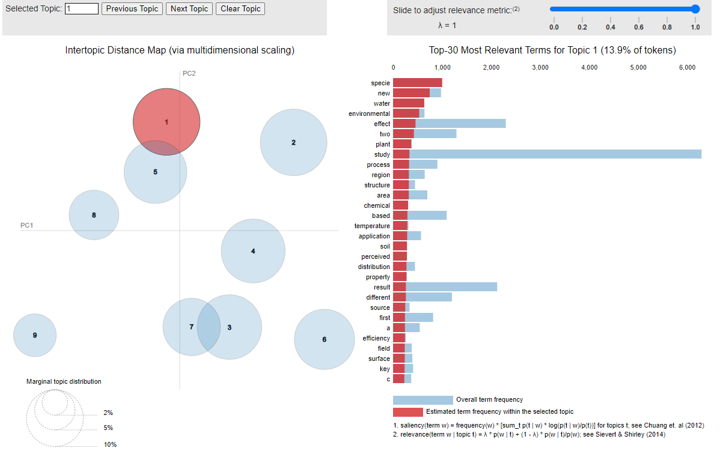
Topics (1) Visualization by pyLDAvis

Slide 25
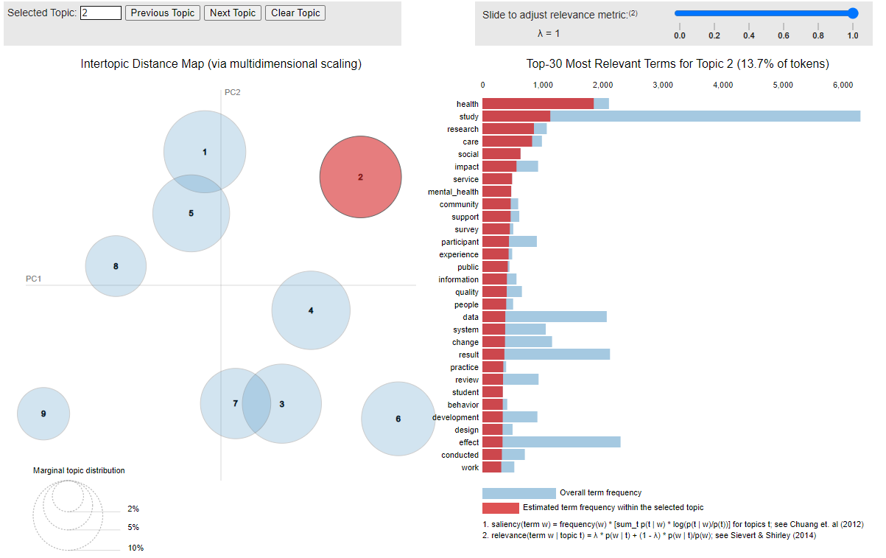
Topics (2) Visualization by pyLDAvis

Slide 26
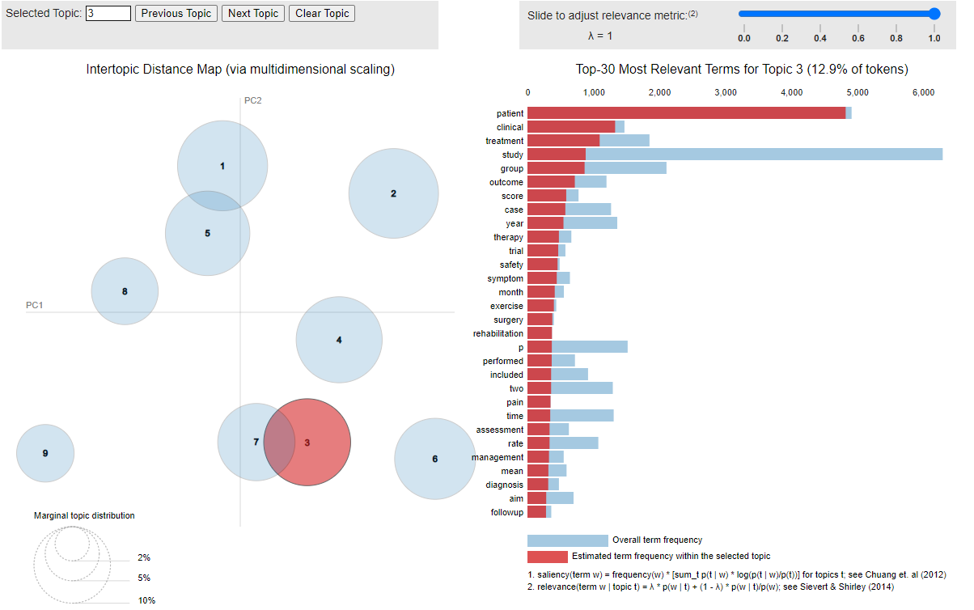
Topics (3) Visualization by pyLDAvis

Slide 27
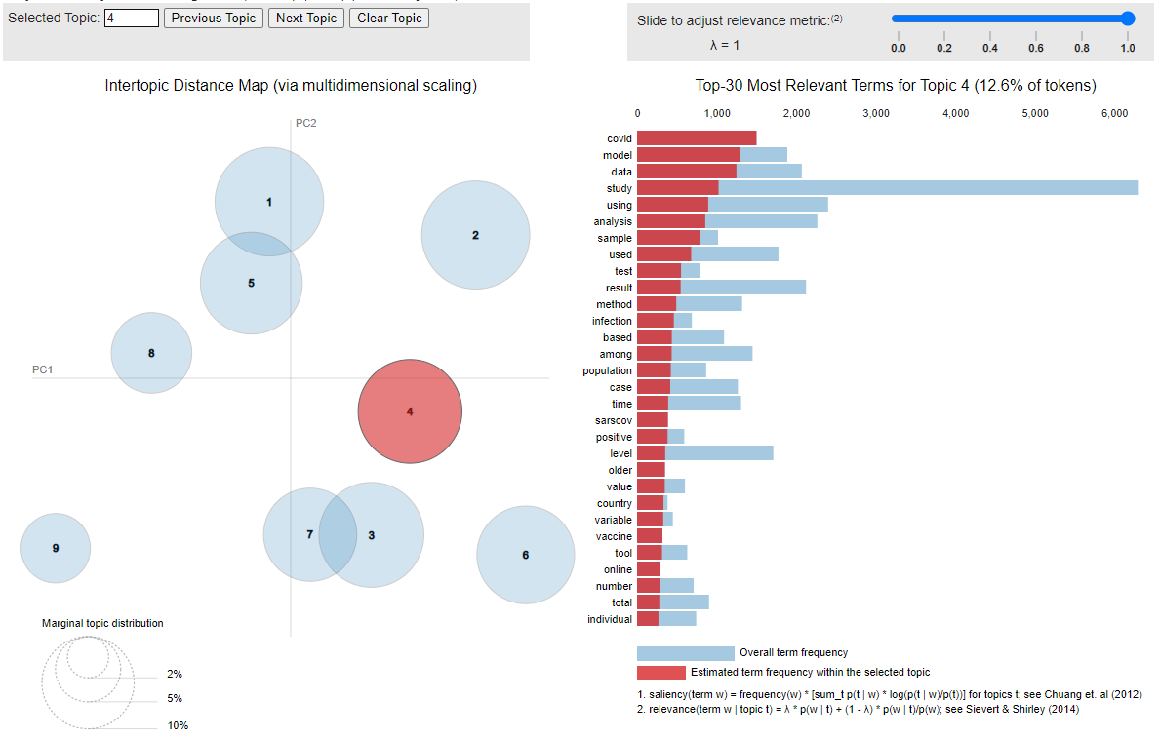
Topics (4) Visualization by pyLDAvis

Slide 28
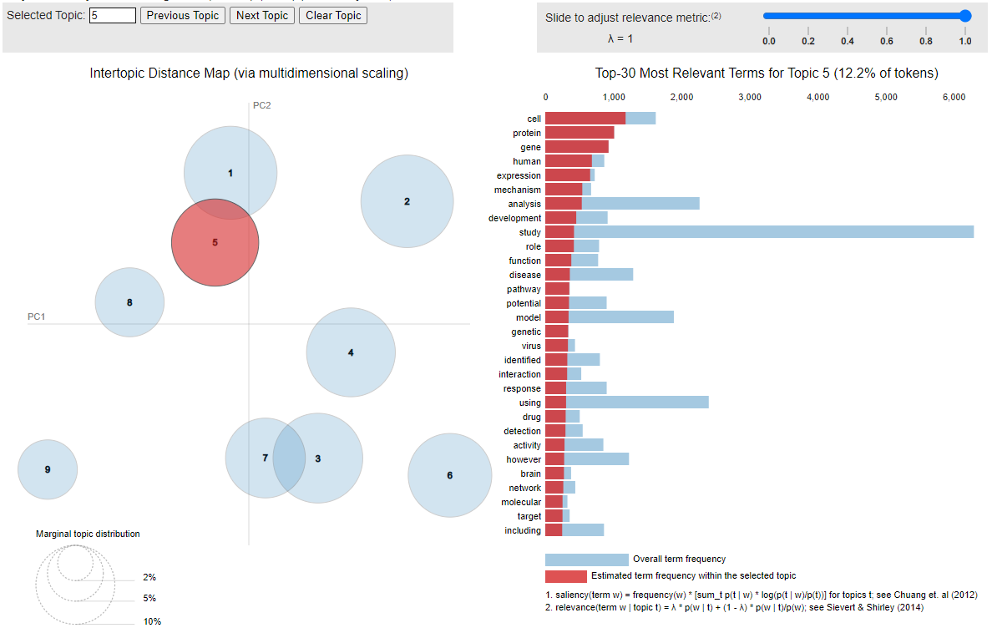
Topics (5) Visualization by pyLDAvis

Slide 29
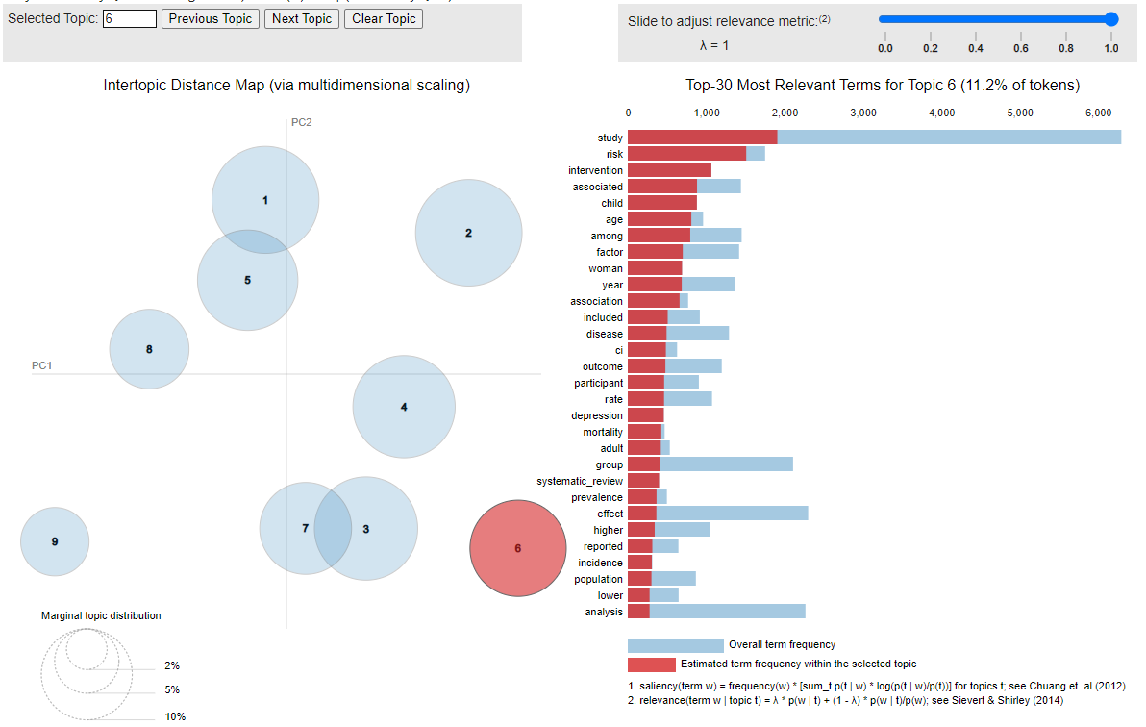
Topics (6) Visualization by pyLDAvis

Slide 30
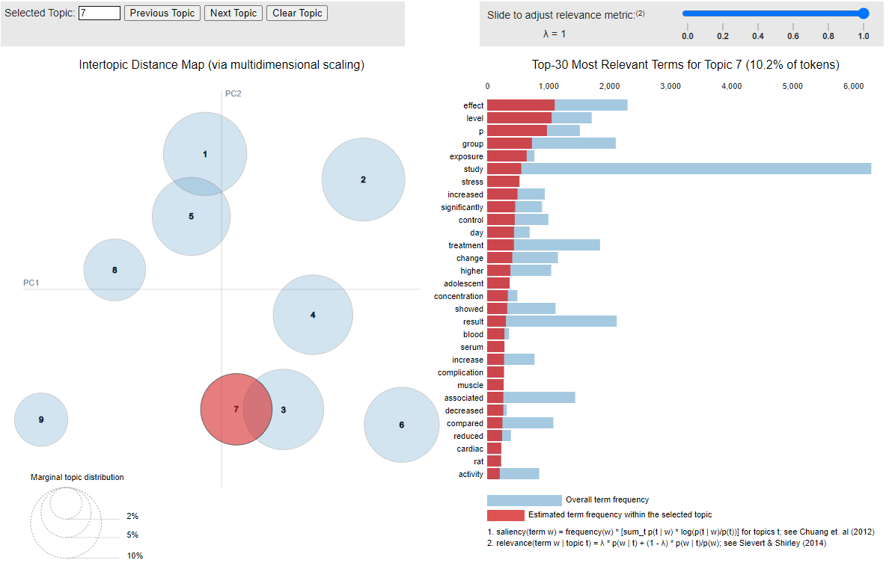
Topics (7) Visualization by pyLDAvis

Slide 31
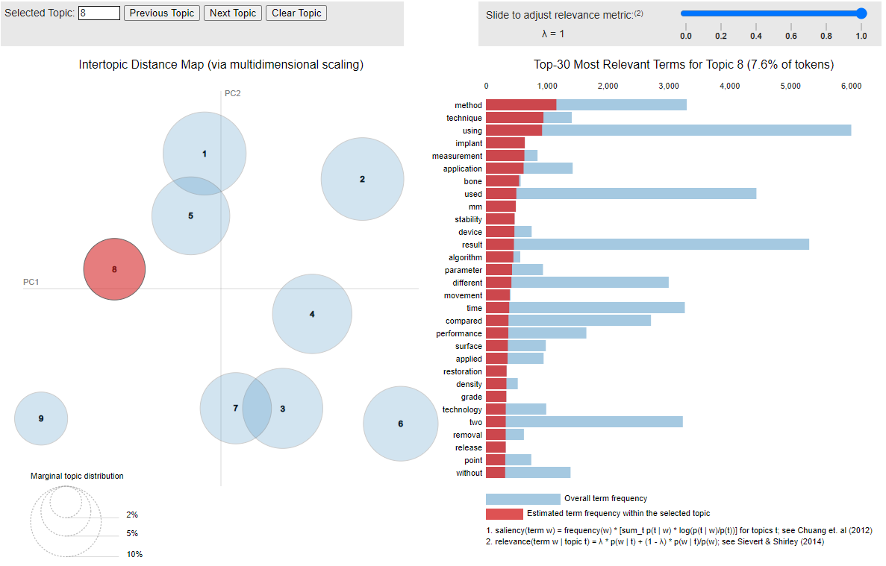
Topics (8) Visualization by pyLDAvis

Slide 32
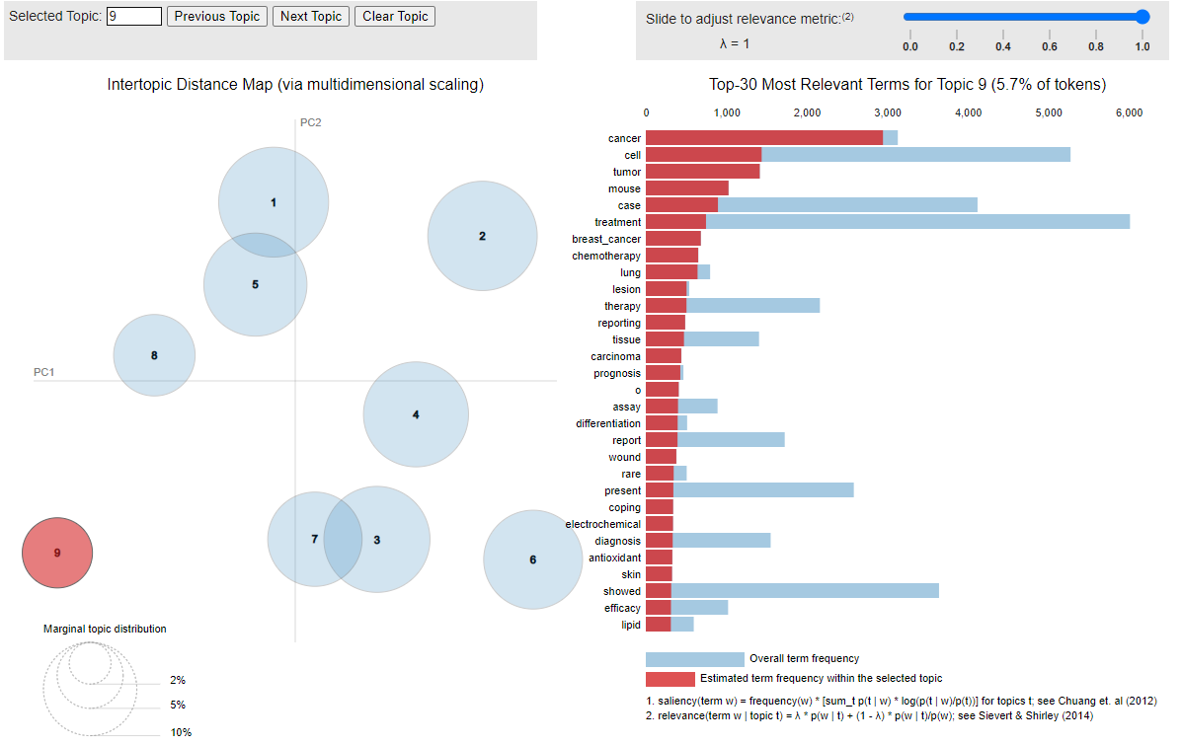
Topics (9) Visualization by pyLDAvis

Slide 33
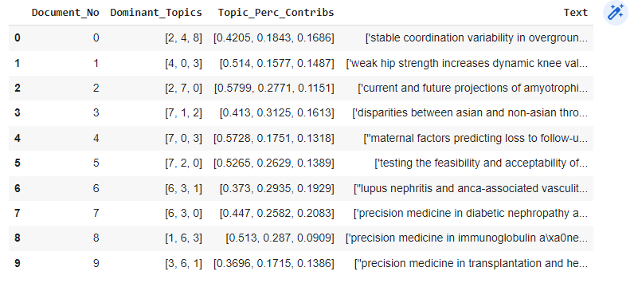
top 3 dominant topics in each sentence
All result saved on CSV file

Slide 34
Results for (Keywords)

Slide 35
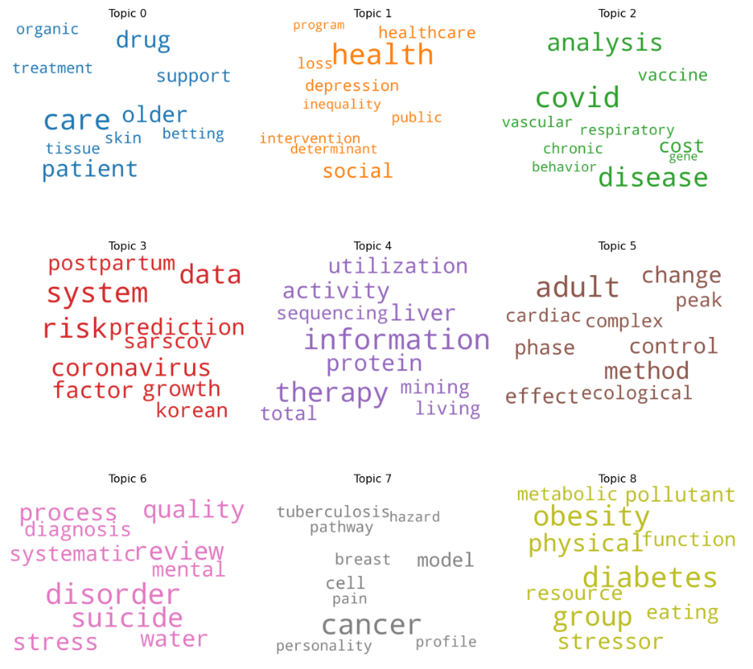
Topics

Slide 36
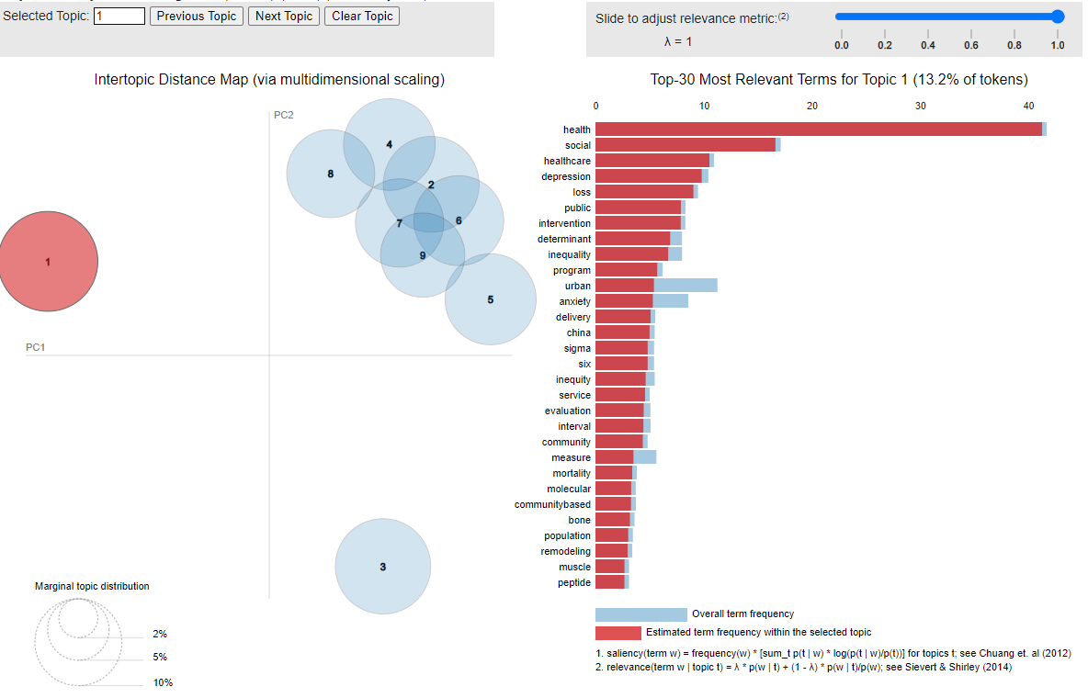
Topics (1) Visualization by pyLDAvis

Slide 37
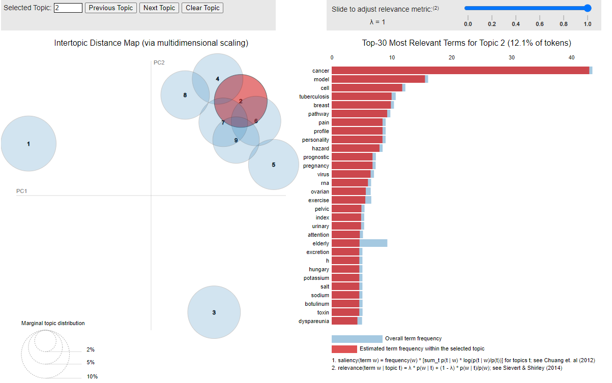
Topics (2,4,5,6,7,8,9,) Visualization by pyLDAvis

Slide 38
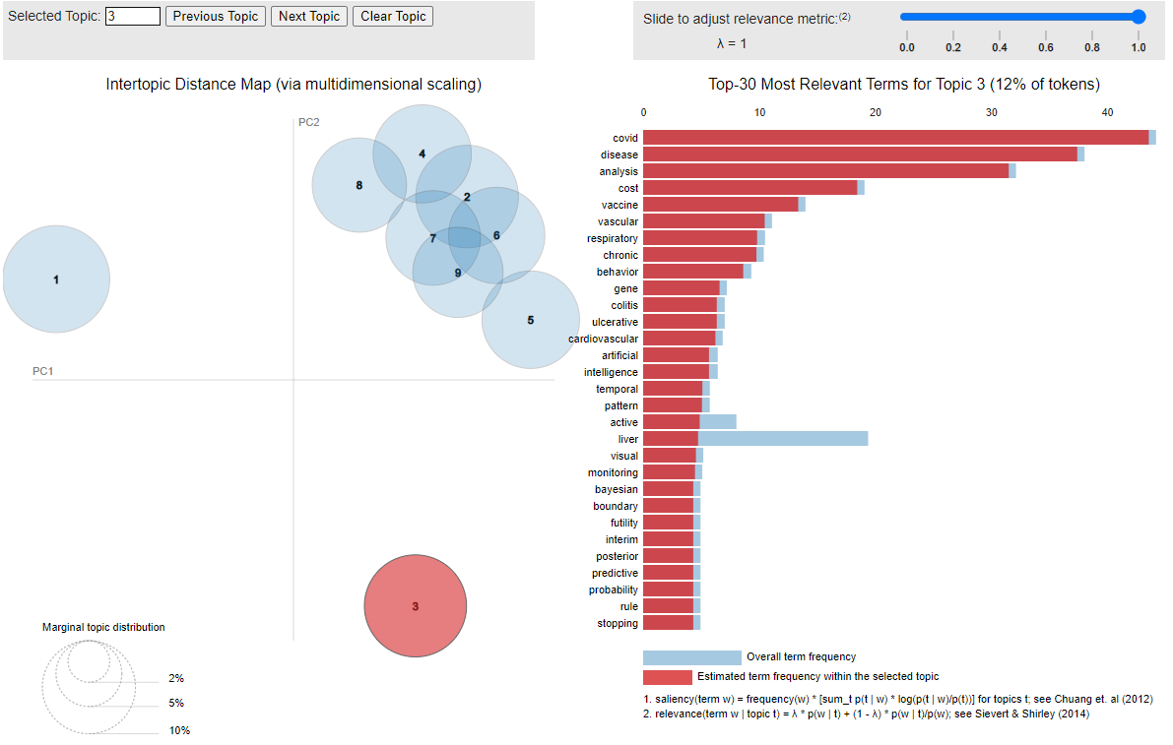
Topics (3) Visualization by pyLDAvis

Slide 39
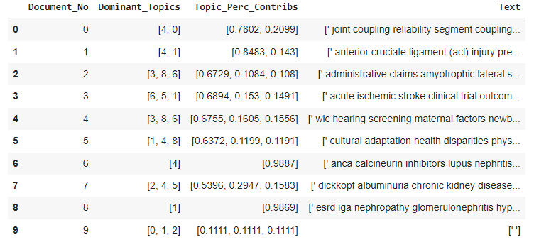
top 3 dominant topics in each sentence
All result saved on CSV file

Slide 40
THANK YOU

